Slide 1
Amazon Product & Review Analysis (Office products and CDs & Vinyl Dataset)

Slide 2

BRIEF OVER-VIEW OF THE COMPANY
The year was 1994 when Jeff Bezos launched Amazon from his garage. In 1995.
The first product launched by Amazon was a book in 50 states and in 45 countries within 30 days.
The Amazon name has become synonymous with online shopping and continues to grow by developing new products, acquisitions, and numerous service offerings to enlarge the customer base.
Nowadays, almost 150.6 million people turn to the Amazon app for most everything.

Slide 3
OBJECTIVE
To develop an automated system to analyse and monitor an enormous number of reviews.
By monitoring the entire review history, analyse tone, language, keywords, and trends over time to provide valuable insights that increase the success rate of existing and new products and marketing campaigns.
Inventory Optimization and Demand Forecasting (Time Series Analysis)
SCENARIO 2
Sentiment analysis of the review text and forecasting (Sentiment Analysis & Time series )
Customer Clustering (Clustering Models)
SCENARIO 1
Forecast what kind of products could be in demand (Clustering Model)
DATA SOURCE

Slide 4

BUSINESS QUESTIONS WHICH WILL BE ANSWERED
How are reviews distributed among three types of sentiments i.e. Positive, Negative or Neutral?
How many customers are loyal customers and are they satisfied with amazon products ?
Which are best and worst performing products on amazon ? And highly recommended products
Which are highly demanded Products on Amazon?
What is the customer retention trend over the years
What is the revenue trend since 1997? Special attention to the main categories i.e. Office products and CDs & Vinyl

Slide 5
BRIEF OVER-VIEW OF THE DATASET
META DATA DICTIONARY
‘title’
‘brand’
‘rank’
‘main_cat’
‘price’
‘asin’ – product id
‘category’
REVIEW DATA DICTIONARY
‘reviewerID’ – customer ID
‘reviewTime’
‘verified’
‘reviewText’
‘overall’
‘summary’
‘asin’
RATING DATA DICTIONARY
‘rating
‘reviewerID’
‘date’
‘asin’

Slide 6







TOOLS AND TECHNIQUES USED FOR DATA CLEANING
Null Value Treatment
Noise Value Treatment – Cleaning and Imputation
Imputation by ways of Iterative imputer
Imputation by ways of Conditional Loops
User defined functions for cleaning and imputation
Imputation

Slide 7
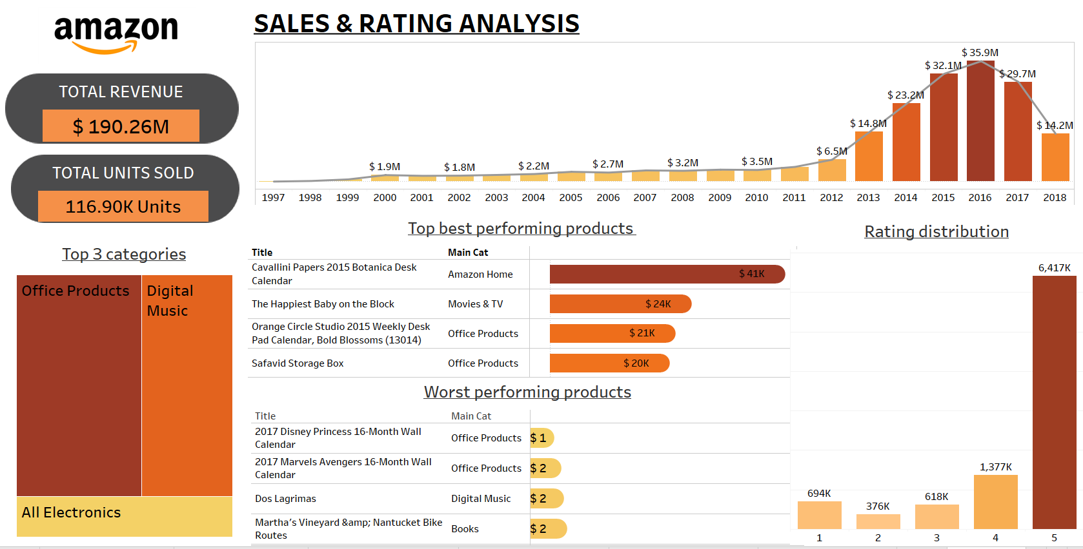
VISUAL ANALYSIS OF THE RATING DATA
Dashboard

Slide 8
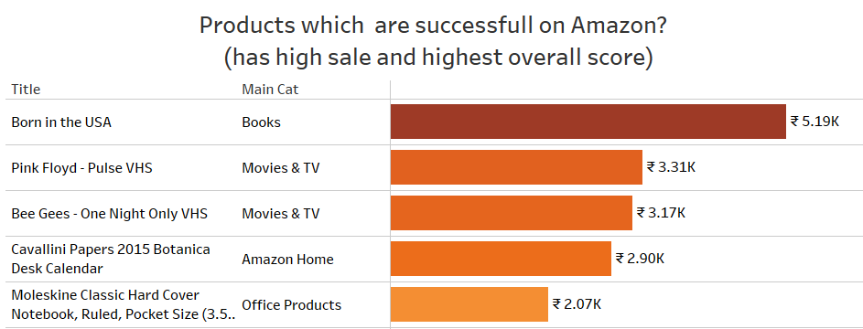
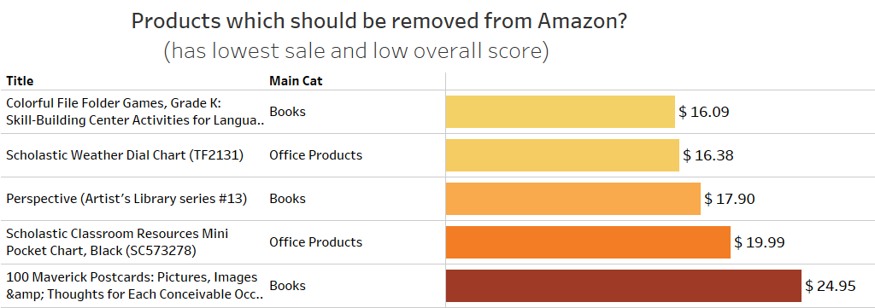
Products which are loved by customers (highest sale and highest overall score)
Products which should be removed from Amazon (lowest sale and lowest overall score)

Slide 9
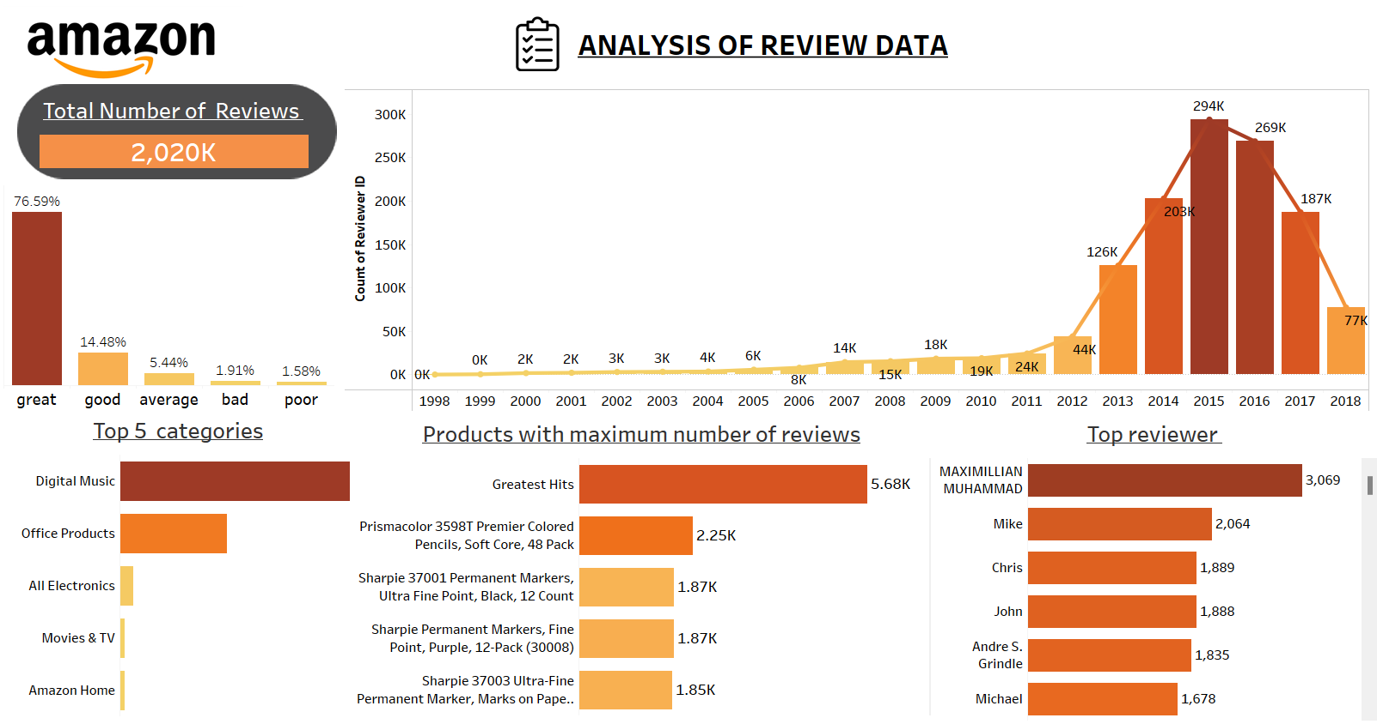
VISUAL ANALYSIS OF THE REVIEW DATA
Dashboard

Slide 10
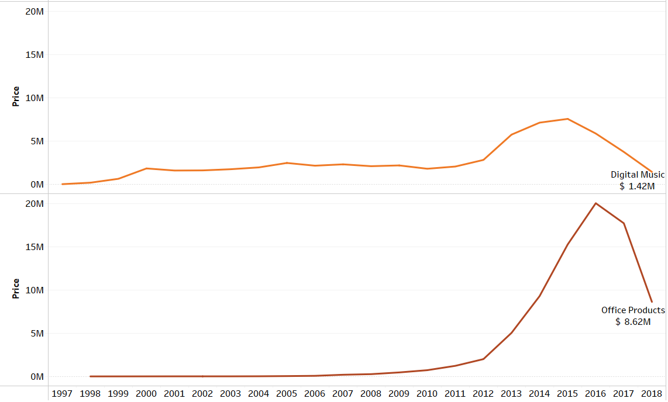
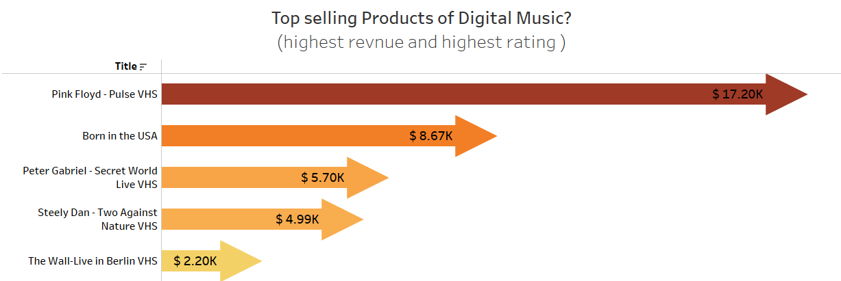
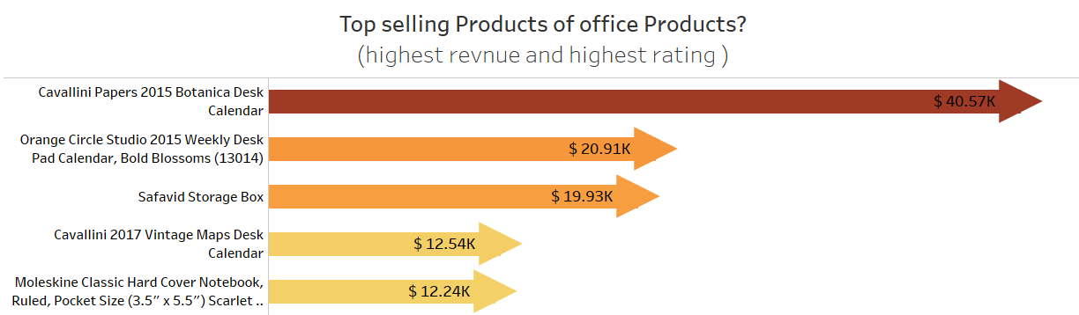
What is the Revenue Trend of the top selling categories?
Total revenue
Digital Music
$ 58.5 Million
Total revenue
Office Products
$ 80.5 Million

Slide 11
BUSINESS PURPOSE OF SENTIMENT ANALYSIS
SENTIMENT ANALYSIS OF REVIEW TEXT
OBJECTIVE : To create a Model for sentiment analysis of reviews posted by the customers and classify the reviews in three categories of Positive, Neutral and Negative.
Customer Satisfaction
To know what is the satisfaction level of individual customers when they shop from Amazon
Product Development
To know which product is loved or hated by the customer. This will result in the better product development and demand forecast.
VaderSentiment vs Textblob

Slide 12
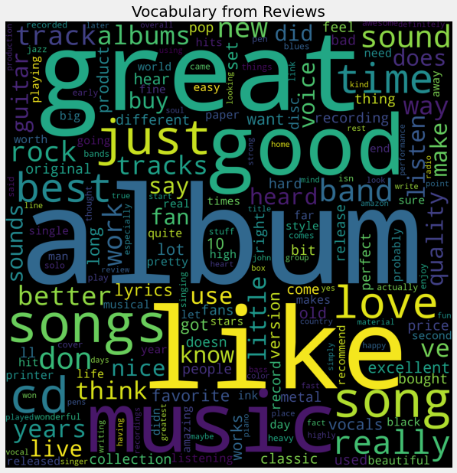
PRELIMINARY ANALYSIS ON REVIEW TEXT
Words like music, songs, album, band shows that there are more reviews for CDs & Vinyl Data
Words like Great, Good, Like, Love has positive connotation

Slide 13
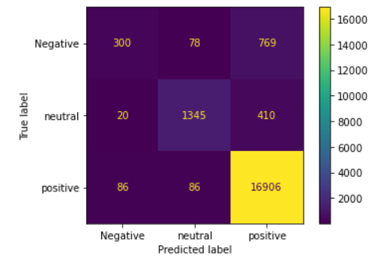
Model – 1 Logistic Regression with OVR Baseline TF-IDF Vectorizer
Model 1 is biased as majority of positive reviews are correctly predicted where as neutral and negative reviews are not correctly predicted.

Slide 14
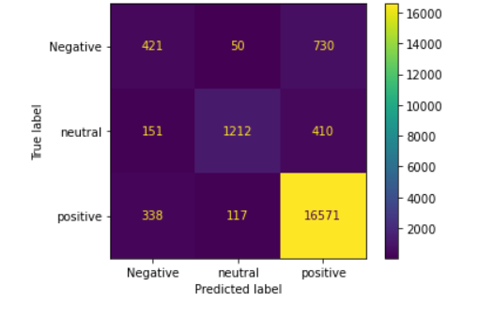


Model 2 – Logistic Regression with OVR Baseline Fasttext
Compared to previous model this model gives a better distribution of correct predictions across the three sentiments. But this model is slightly biased towards positive sentiment.

Slide 15
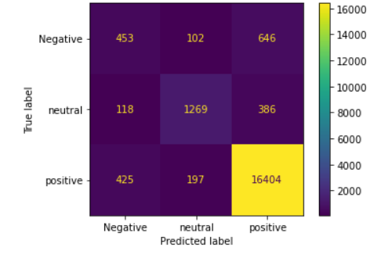
Model 3 – Random Forest baseline Fasttext
Compared to previous models this model gives a better distribution of correct predictions across the three sentiments with the least biasness.

Slide 16
FINAL COMPARISON OF THE MODELS
Model | Correct predictions | Biasness
Logistic Regression-OVR baseline TF-IDF | 93% | Biased towards Positive & Neutral sentiments
Logistic Regression-OVR baseline Fasttext | 90 % | Slightly biased towards Positive & Neutral sentiments
Random Forest classifier baseline Fasttext | 90% | Least biased of all
INPUT TEXT | Model - Random Forest Classifier baseline Fasttext vectorizer | OUTPUT SENTIMENT
'Poor quality. Fault device.’ ----------------→ |  | ------------→ Negative
'books for office’ ----------------→ |  | ------------→ Neutral
'Happy with the product’ ----------------→ |  | ------------→ Positive

Slide 17
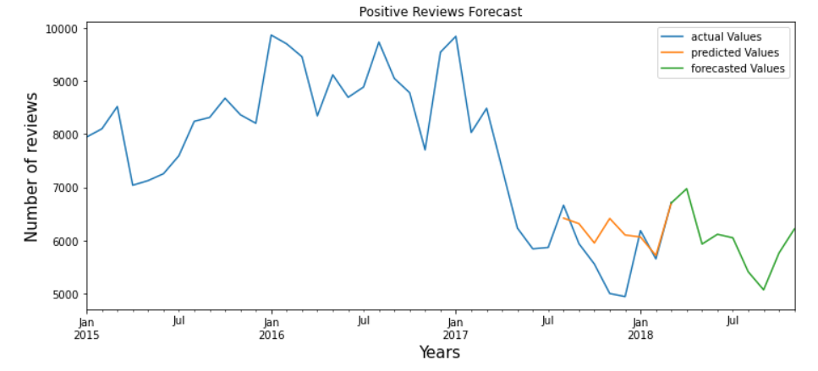
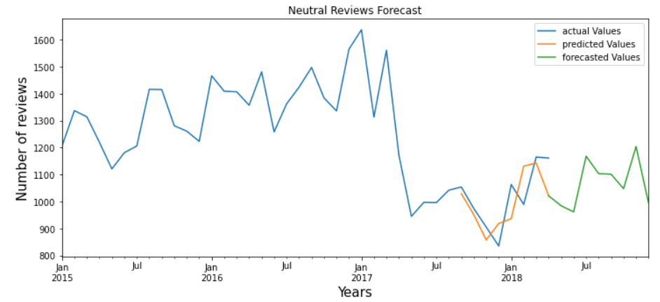
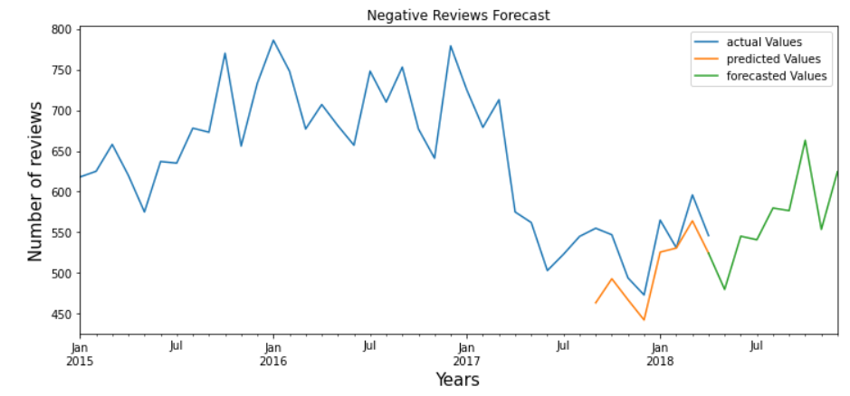
TIME SERIES ANALYSIS FOR FORECASTING FUTURE SENTIMENTS

Slide 18
OBJECTIVE: To find different types of customers present in Amazon.
CLUSTERING OF CUSTOMERS
Criteria for clustering:
The overall sentiment of a person as customer
Number of orders placed by a customer
The total amount spent by the customer
For how long a person has been Amazons customer

Slide 19
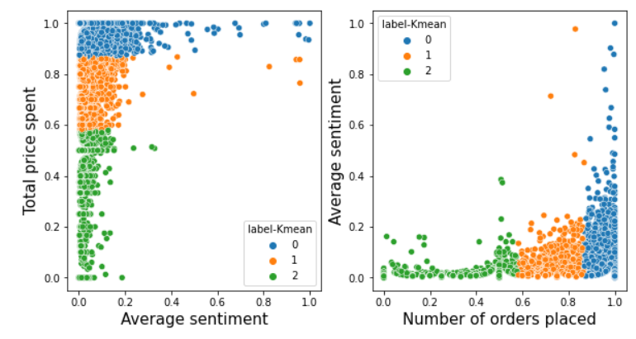
Average Sentiment
Total orders placed
Total price spent
Average Sentiment
Label | Average Sentiment | Total price spent | Number of orders
0 | Positive | Low to high | Low to high
1 | Neutral | Low to Mid | Low to Mid
2 | Negative | Low | Low
List of customers : SATISFIED NEUTRAL NOT SATISFIED

Slide 20
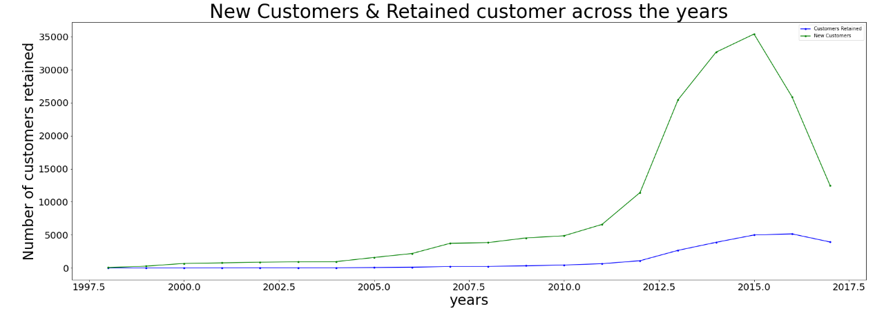
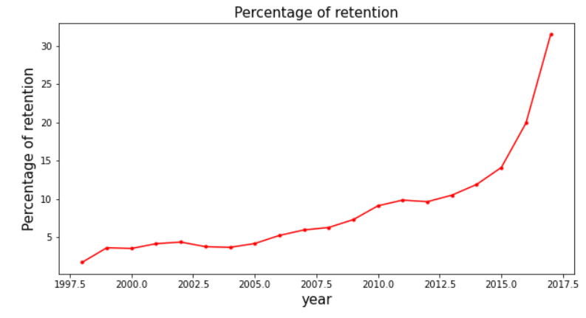




NEW CUSTOMERS & CUSTOMER RETENTION FORECASTING
New customers earned by Amazon each year
Out of new customers how many customers were retained till 2018
Customer retention TABLE

Slide 21
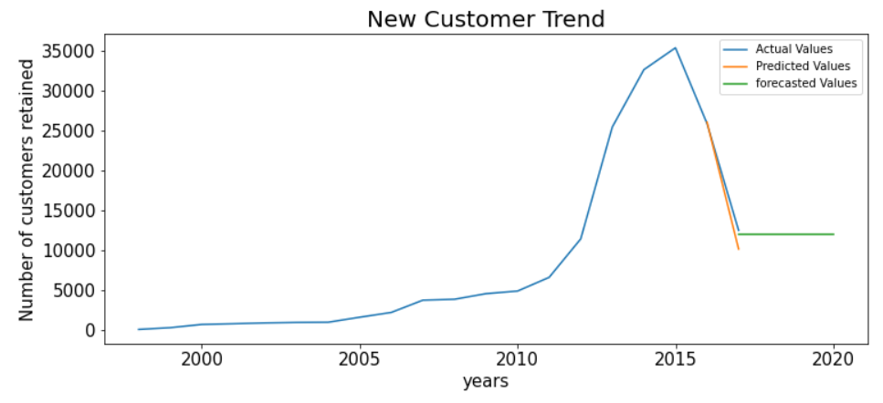
NEW CUSTOMERS FORECASTING
Trend of new customers is likely to become stagnant for next 3 years
Customer retention TABLE

Slide 22
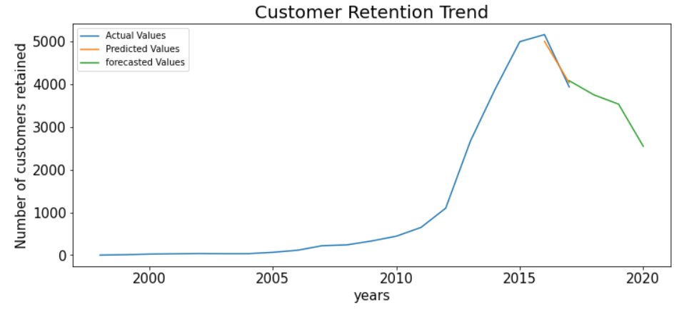
CUSTOMERS RETENTION FORECASTING
Trend of customers retention is likely to fall for next 3 years

Slide 23
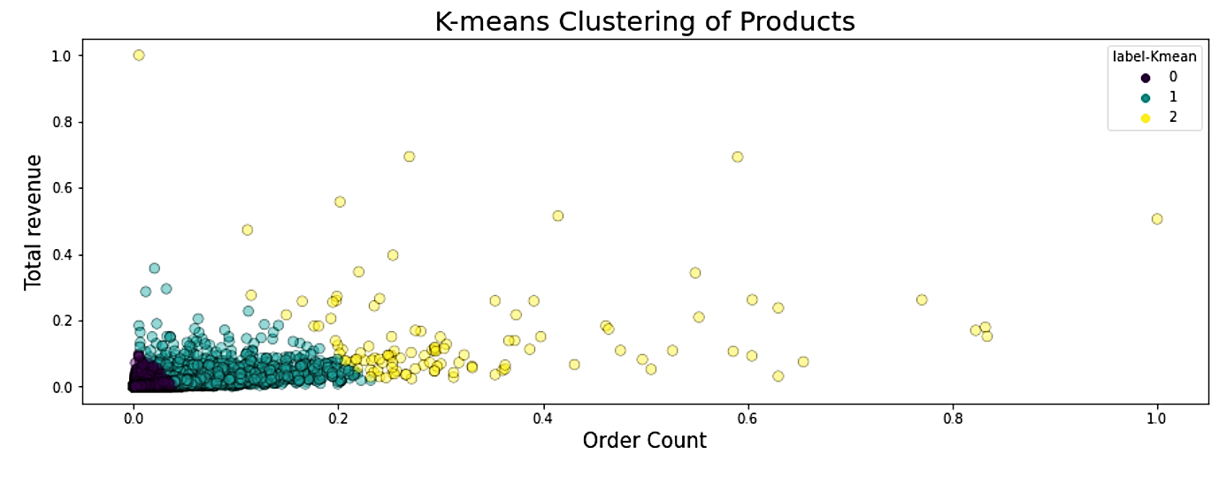
CLUSTERING OF PRODUCTS
OBJECTIVE: To find out which products are highly demanded for inventory optimization
Number of orders placed
Label 0 Low demanded Label 1 Average demanded Label 2 High demanded

Slide 24
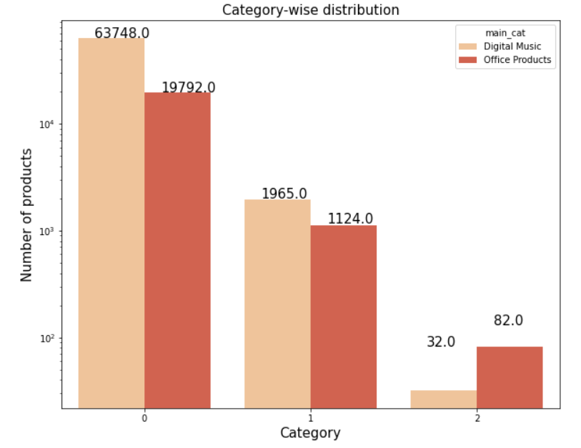
Distribution of main categories
Features of each demand category
Demand | Label | Quantity sold | Total_sales (revenue)
Low | 0 | 1-95 units | $0.05 - $9,599
Medium | 1 | 13-521 units | $37 - $34,866
High | 2 | 251-2246 units | $2,370 - $97,684
Low Average High
Demand

Slide 25
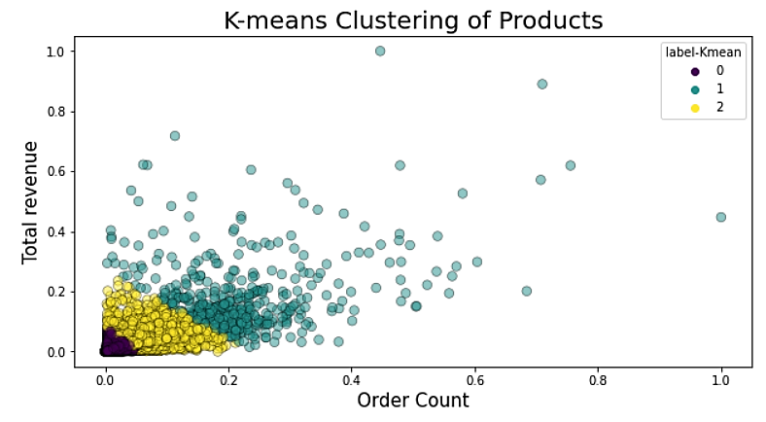
DIGITAL MUSIC
Top 5 products
ProductID | Title | Total orders | Total revenue
B00L98V4UW | 25 | 1183 | $10,635
B000002IQ1 | Led Zeppelin | 894 | $14,728
B000VZK7T8 | Nevermind | 840 | $21,176
B0000025H6 | The Wall | 810 | $4,787
B000002H98 | Metallica | 715 | $7099
HIGHLY DEMANDED PRODUCTS DIGITAL MUSIC DATA
Quantity ordered

Slide 26
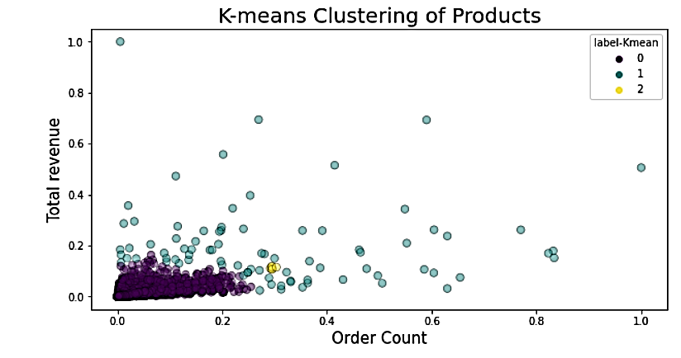
OFFICE PRODUCTS
Top 5 products
ProductID | Title | Total orders | Total revenue
B00006IEEV | Prismacolor 3598T | 2246 | $49,412
B00A89YZ6S | Sharpie 37001 | 1873 | $14,815
B00006IFEU | Sharpie Permanent marker | 1869 | $21,176
B00006IFI5 | Sharpie 37003 Ultra-Fine | 1848 | $17,512
B00006JNJD | Pilot G2 Retractable Premium Gel Ink | 1730 | $16,595
Quantity ordered
HIGHLY DEMANDED PRODUCTS
OFFICE PRODUCT CATEGORY

Slide 27
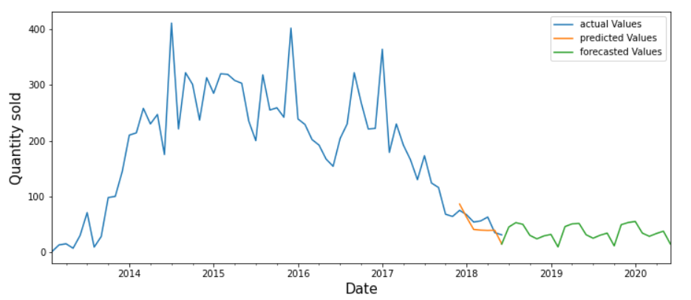
FORECASTING THE DEMAND OF A PRODUCT
Using time Series analysis for demand forecast of the top selling product of office product
Product ID : B00006IEEV Product title – “PrismaColor”
Main Category: Office Product

Slide 28
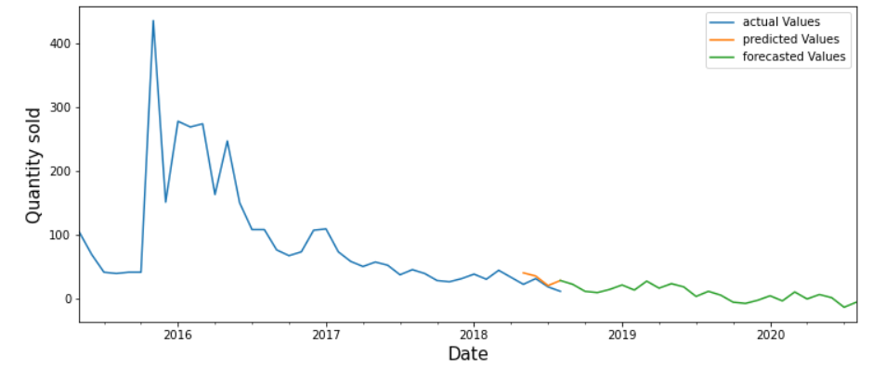
Product ID : B00SWBLS3C Product title – “Traveller”
Main Category: Digital Music

Slide 29
FINAL CONCLUSIONS ON ALL THE MODELS
Fall in positive reviews for next 12 months
Rise in negative reviews for next 12 months
Fall in customer retention for the next 3 years
PRODUCT CLUSTERING: (Out of 86,743 products)
High demanded products
Average demanded products
Low demanded products
CUSTOMER CLUSTERING : (Out of 1.78 Lakh customers)
1.24 Lakh - Happy customers (SATISFIED)
43.2 Thousand - Average satisfaction (NEUTRAL)
11.1 Thousand - Not Happy (NOT SATISFIED )
Out of 1,78,529 customers 23,959 customers are retained
Retained customers
WORKING CODE

Slide 30
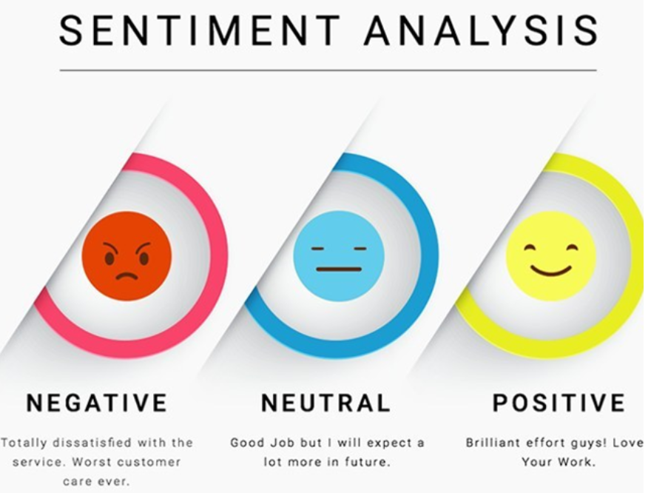
So what are your sentiments about the project ?
THANK YOU !!
Presented by :
Apoorva Mishra

